Slide 1
The Buildings Show
INTELLIGENT BUILDINGS CAN IMPROVE ORGANIZATIONAL PRODUCTIVITY
December 4, 2019 | 10:30 AM-12 PM
Ron Zimmer
CABA President & CEO
Connect to what’s nextTM
www.CABA.org

Slide 2





CABA Overview
CABA (Continential Automated Buildings Association)
Vision
CABA advances the connected home and intelligent buildings sectors.
Mission
CABA enables organizations and individuals to make informed decisions about the integration of technology, ecosystems and connected lifestyles in homes and buildings.
2

Slide 3

CABA Board of Directors
3

Slide 4
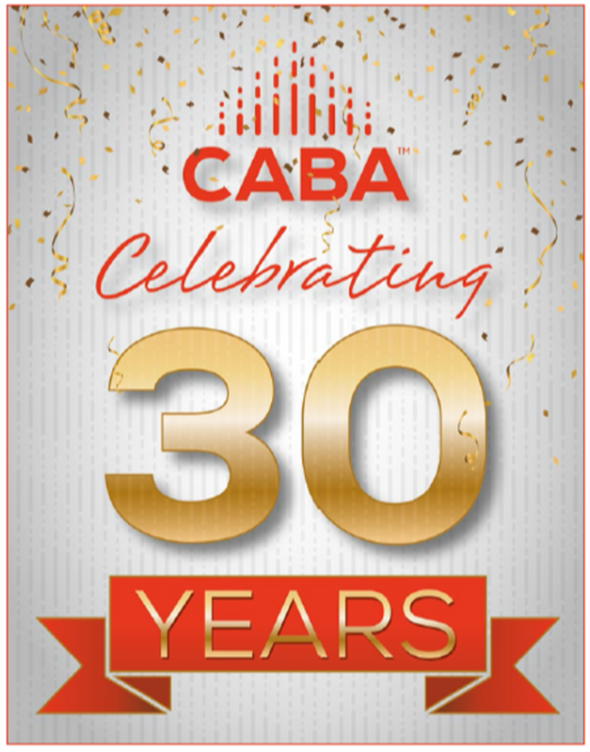
CABA 30th Anniversary
4

Slide 5
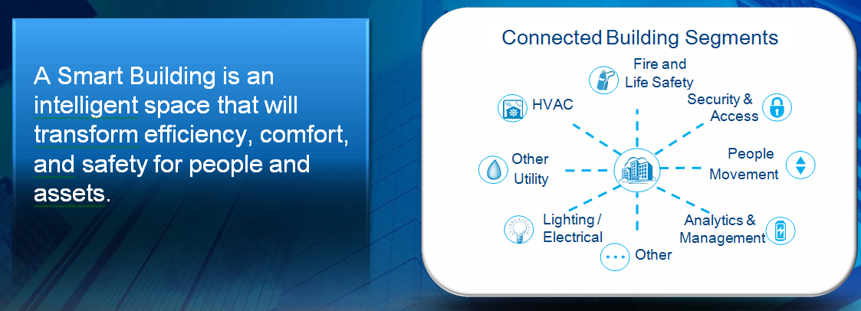
Smart Buildings – Networked, Intelligent, Adaptable…
5

Slide 6
The Architecture of a Buildings Automation System (BAS)
6

Slide 7
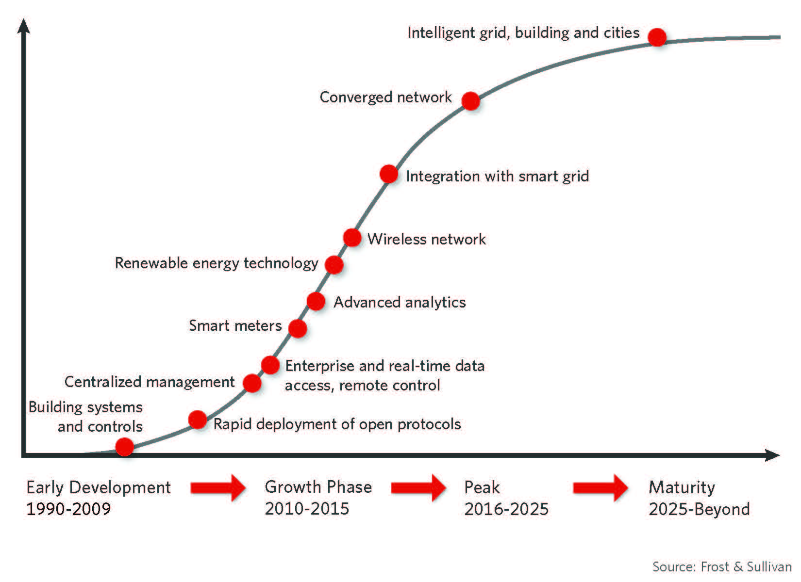
Intelligent Building Solutions Market Lifecycle Analysis
7

Slide 8
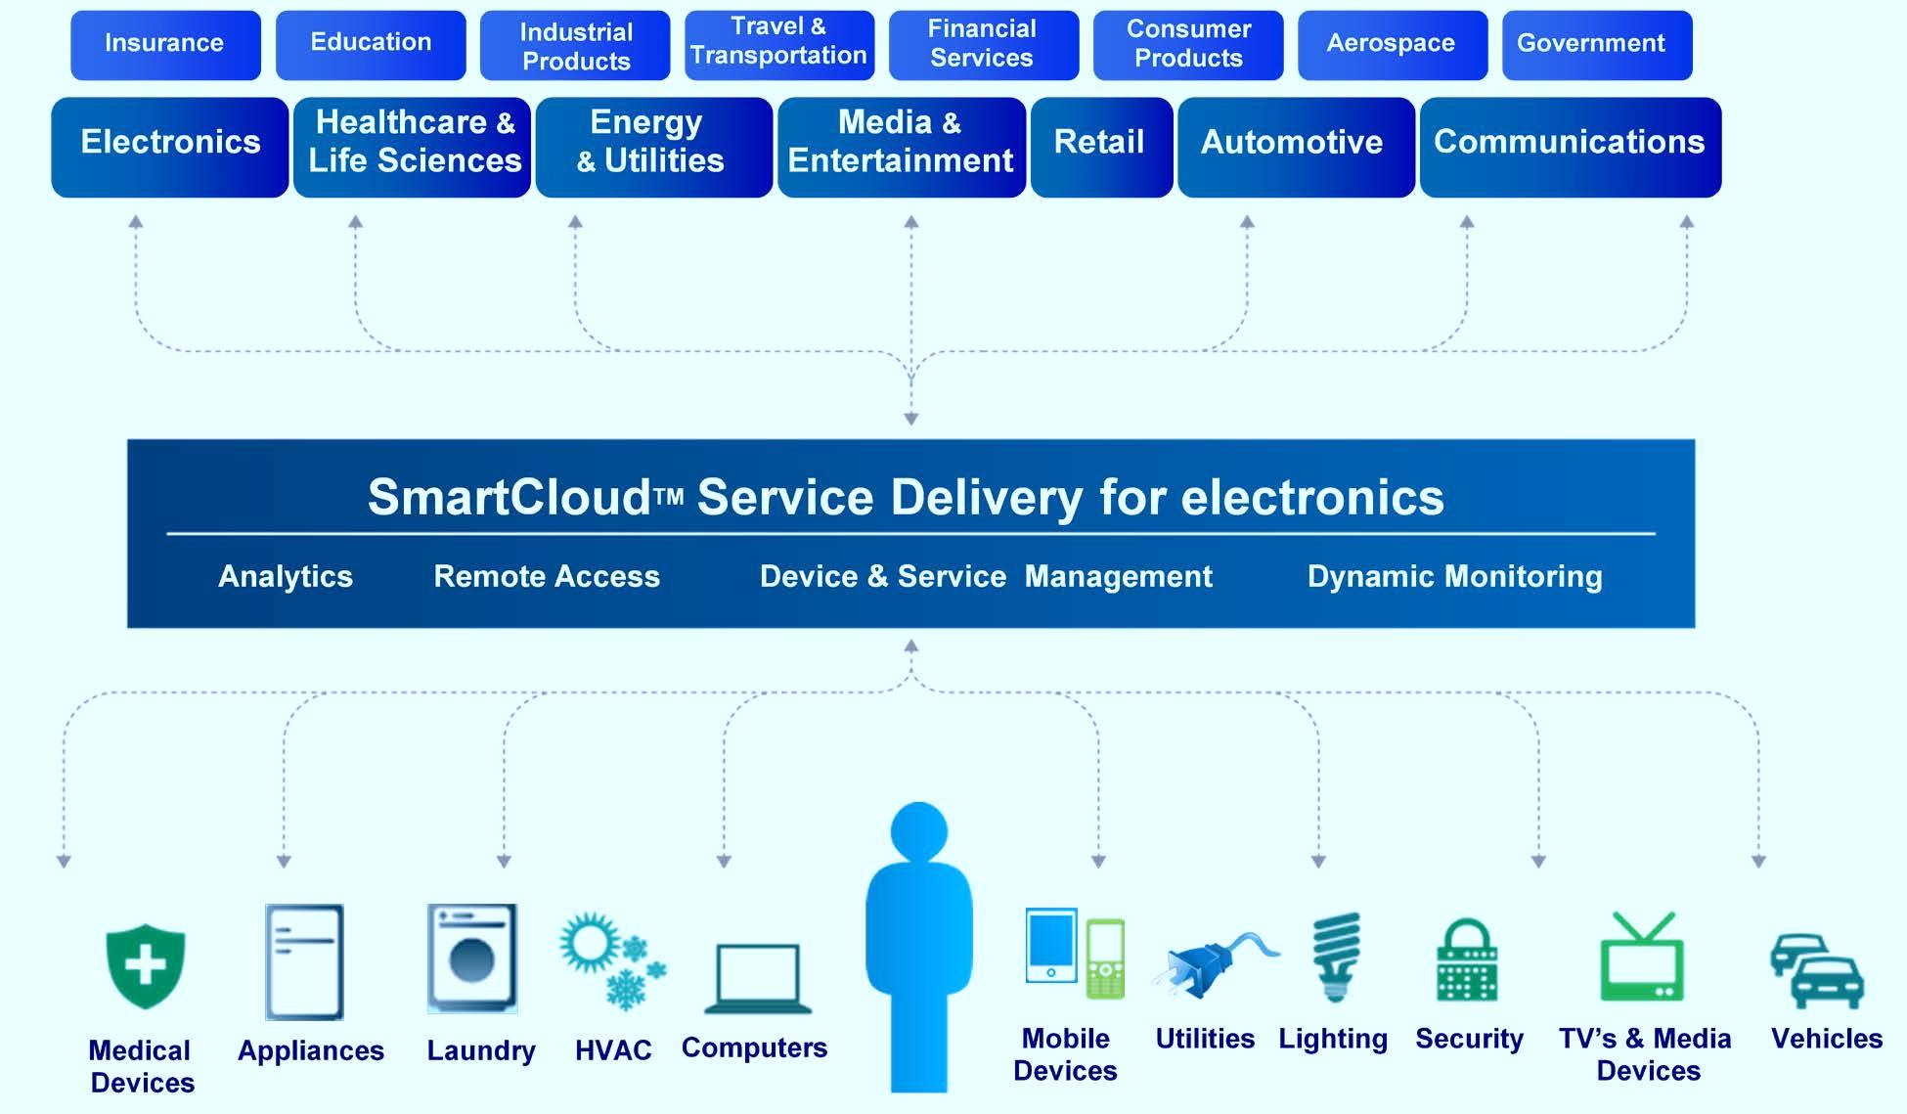
Enterprise Convergence Platform and Cloud Technology
8

Slide 9
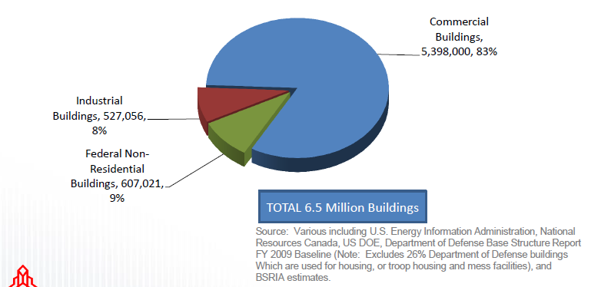
Non-Residential Building Stock - North America
9

Slide 10

World’s “Greenest Office Building”
10

Slide 11


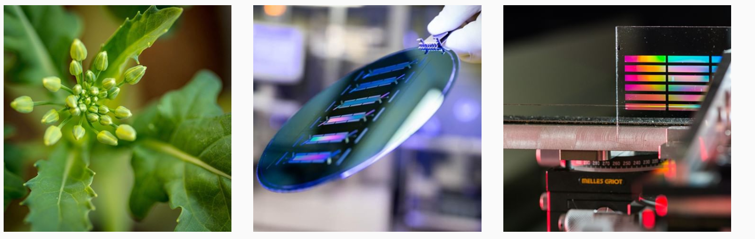
National Research Council – CABA Board Member
11

Slide 12

Project Funders
Improving Organizational Productivy
with Building Automation Systems
Complimentary copy of Report:
www.caba.org/productivity
12

Slide 13
Background and Objectives
CABA and its members have expressed a renewed Industry focus on how buildings can:
    Improve organizational productivity
    Contribute to increasing the ROI of building systems
Tenants in a competitive real-estate environments are looking for green, sustainable, comfortable and healthy buildings
In 2014, NRC and CABA collaborated on a White Paper
    Improving Org. Prod. with Building Automated Systems
    Established a framework for quantifying and valuing benefits of an enhanced BAS on Org. Prod.
13

Slide 14
Background and Objectives
2014 White Paper was followed by a CABA Boutique Research Project
  Improving Organizational Productivity with Building Automated Systems: Phase 1 was completed by NRC and is available for download (caba.org./productivity)
  Project reviewed published work in engineering, psychology, business, public health, etc.
  Results demonstrated better building strategies having positive effects on multiple org. prod. metrics, comparable in size to other corporate strategies that lack environmental benefits:
    Absenteeism/ Employee turnover intent/ Self-assessed performance/ Job satisfaction/ Health, etc.
14

Slide 15

Executive Summary
New approach to quantifying organizational productivity effects
“Better buildings” strategies have positive effects on multiple metrics related to organizational productivity
Effects similar in size to other corporate strategies affecting employee health, well-being and performance
15

Slide 16
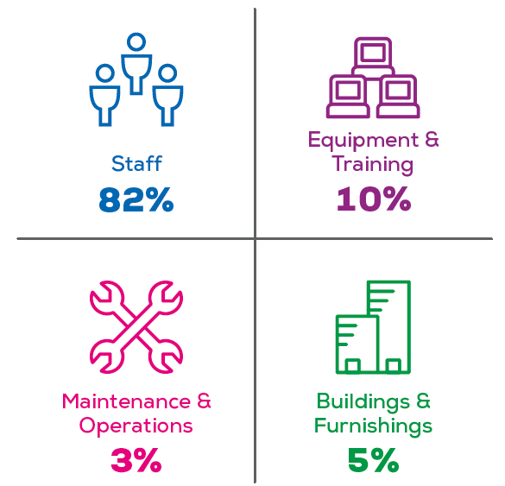
Approach
Use the buildings budget to enhance the salaries and benefits part of the budget
16

Slide 17
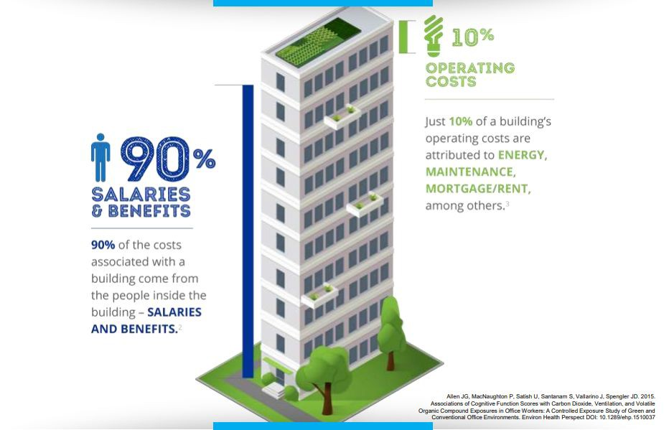
The “Forgotten” 90%
17

Slide 18
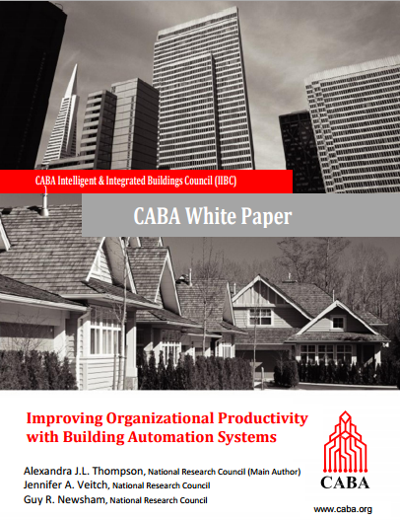
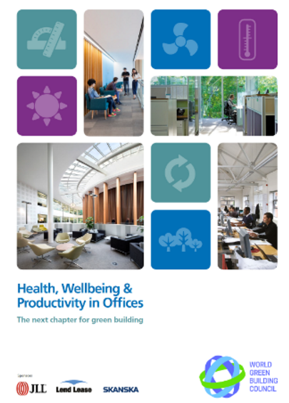
The Forgotten 90%
Traditional productivity thinking not applicable to modern office work
Multiple metric approach from CABA and World Green Building Council (WGBC)
Balanced scorecard
concept widely
accepted in other
contexts
18

Slide 19
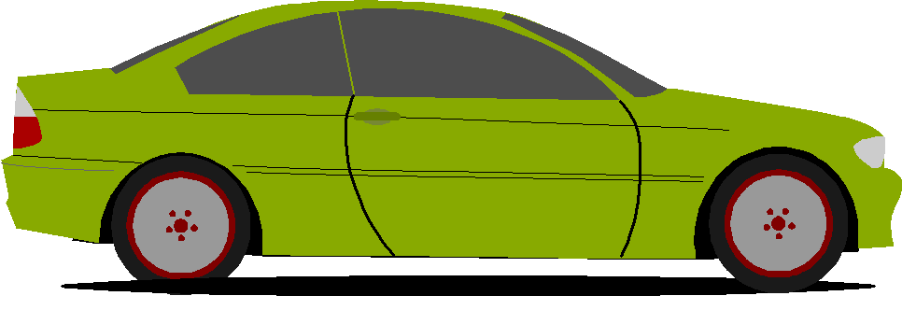

Approach – analogy to improving energy performance
Does my energy performance need to be improved?
→ benchmarking
Assess several strategies to improvement
Benefits often better expressed in equivalent terms
Apply this process across multiple metrics related to organizational productivity
# cars off the road
Planting # trees
19

Slide 20

Organizational Productivity Metrics
Benchmarks developed for these items:
Absenteeism
Employee turnover intent
Self-assessed performance
Job satisfaction
Health and well-being
Complaints to the Facility Manager
20

Slide 21
Organizational Productivity Metrics
Better buildings
Office type (private vs open-plan)
Workplace health programs
Bonuses
Flexible work options
Peer-reviewed literature synthesized for effects on each organizational productivity metric
    > 4,000 abstracts, and 500 full publications reviewed
    Studies from real office workplaces only
21

Slide 22
Results
 | Strategies (IV)➔ | Better Buildings | Office Type | Workplace Health Programs | Bonuses | Flexible Work Options
Benchmark ⬇ | Metrics or KPIs (DV)⬇ |  |  |  |  |  | Unit ⬇
2 – 15 | Absenteeism | ⬇ 0.4 – 1.5 | ⬇ 3.2 | ⬇ 0 – 1.8 | ⬇ 1.0 |  | day/per/yr
18 – 30 | Employee Turnover (int.) | ⬇ 1.3 | ⬇ 18 | 0 | ⬇ |  | 0 – 100
0 | Self-assessed Performance | ⬆ 2 – 10 | ⬆ 8– 15 | ⬆ 0 – 10 | ⬆ |  | %
60 – 80 | Job Satisfaction | ⬆ 4 – 9 | ⬆ 5 – 10 | ⬆ 0 – 12 |  | ⬆ 0 – 10 | 0 – 100
30 – 60 | Health & Well-being (symptoms) | ⬇ 5 – 9 | ⬇ |  |  |  | 0 – 100
55 – 75 | Health & Well-being (overall) | ⬆ 6 – 10 | ⬆ 11 – 12 | 0 |  | ⬇ 6 | 0 – 100
22

Slide 23

Research Gaps
New outcomes for high-profile concepts;
e.g., employee engagement, creativity,
new employee attraction, communication,
and presenteeism
Analysis of archived FM complaints data
Longitudinal data analysis to establish
causation and persistence of effects
Measures of in-situ job performance
Leverage Internet of Things (IoT), and wearables, to enhance existing metrics, or to develop new metrics
Common measurement scales and reporting
formats
23

Slide 24
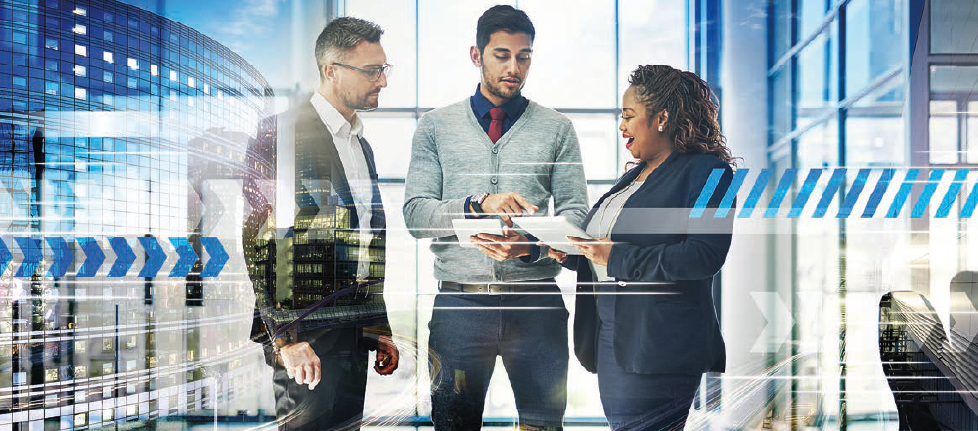
Evidence for Retrofits that Improve Organizational Productivity
Phase 2: Task Force
Bianca Van Der Zande (Signify/Philips)
Brandon Buckingham (Steelcase Inc.)
Craig Walker (United Technologies Research Center)
David Sapoznikow (Intel Corporation)
Greg Walker (CABA)
Jennifer Veitch (National Research Council)
Rachna Stegall (UL LLC)
Rimes Mortimer (Microsoft Corporation)
Ron Zimmer (CABA)
Stephen Becker (Kimberly-Clark Professional)
Trevor Nightingale (National Research Council)
Tucker Boren (Acuity Brands, Inc.)
24

Slide 25
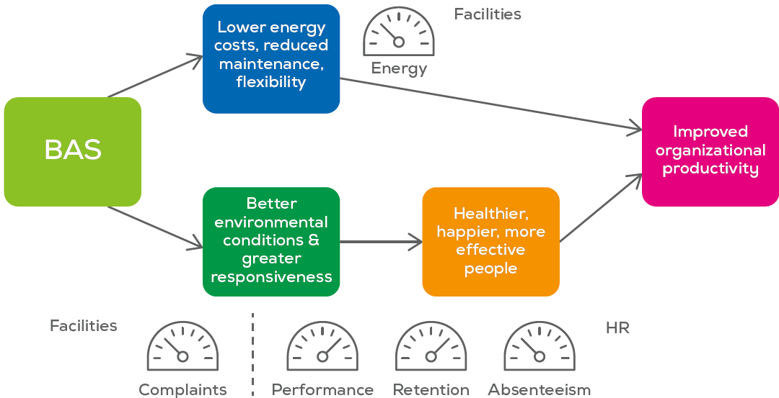
Phase 2: Overview
Phase 2 will examine the effect of building characteristics and systems on multiple metrics in the same organization
Much of the necessary data already exists – it then must be accessed, collated and analyzed by building features
Consortium of funding and data partners via CABA
25

Slide 26
Phase 2: Work Plan
The work under Phase 2 will comprise two stages:
  Acquisition of relevant anonymized RE and HR data from one or more partner organizations
  Analysis of these data to quantify how investments in building technologies affect org. prod. metrics
Retrofit 1
Retrofit 3
Retrofit 2
Bldg 1
Bldg 2
Bldg 3
Bldg 4
HR survey & data 1
HR survey & data 2
HR survey & data 3
HR survey & data 4
26

Slide 27
Phase 2: Deliverables
Project partners will:
  Form a steering committee to shape research decisions
  Have the opportunity to review draft documents, and provide comments prior to delivery of final versions:
    Detailed report
    PowerPoint slide deck
    Version of final report edited for submission to a scientific journal
27

Slide 28

Phase 2: Costs
Cost to become a funder is $5K - $15K
In addition, this project will require data to be donated by one or more organizations. The cost of preparing the data in a format suitable to protect privacy and to be ready for the NRC to analyze are expected to be in-kind costs borne by the donor organization
Donor organizations will be considered full project partners and will have a seat on the Steering Committee
28

Slide 29

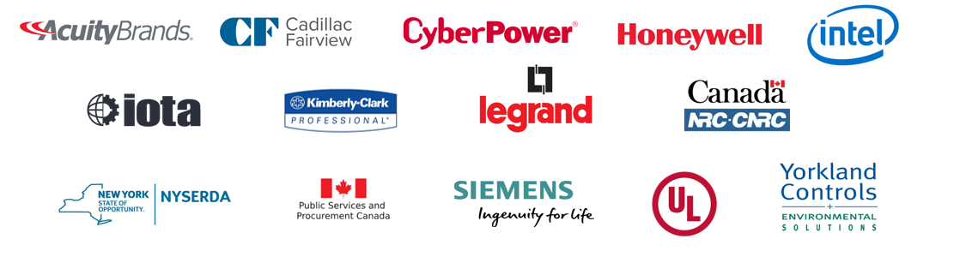

IBC Research - Current
2019 “Evidence for Building Retrofits that Improve Organizational Productivity (Phase 2)”
Free Download of Phase 1: www.caba.org/productivity
29

Slide 30

Siemens Smart Buildings
30

Slide 31



You’re Invited…
CABA
SMART BUILDINGS
SUMMIT
PRODUCED BY:
May 3 - 5, 2020
Sawgrass Marriott Resort & Spa | Ponte Vedra Beach, FL
31
© 2019, Continental Automated Buildings Association

Slide 32
CONTACT CABA
Continental Automated Buildings Association (CABA)
613.686.1814
Toll free: 888.798.CABA (2222)
caba@caba.org
www.CABA.org
www.twitter.com/caba_news
www.linkedin.com/groups?gid=2121884
Connect to what’s next™
32

