Slide 1
Agenda – Building Awareness and External Relations
A. Agenda
B. About the “Building Awareness and External Relations” Working Group
C. Review and discussion of three (3) main tactics
1) Enhance channels to build awareness of CABA as a key industry resource for research and networking
2) Develop a content marketing strategy to enhance external relations
3) Use social media to raise profile of CABA
D. New business or recommendations
E. Adjournment

Slide 2
About the “Building Awareness and External Relations” Working Group
“Building Awareness and External Relations” Working Group
Byron BeMiller, Semtech
Todd Denison, UL LLC
Trevor Deters, Steelcase Inc.
Charles Hume, Southwire Company, LLC
Jim Hunter, Delos Living LLC
Brian White, Rheem Manufacturing Company
Conrad McCallum, CABA
Greg Walker, CABA
Ron Zimmer, CABA, Acting Chair

Slide 3
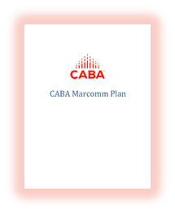
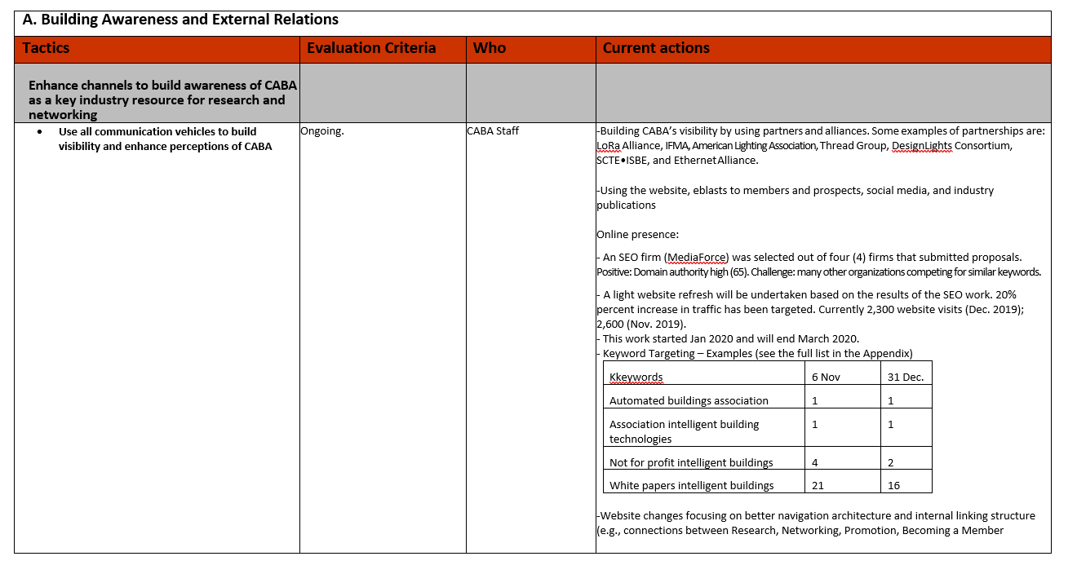
About the “Building Awareness and External Relations” Working Group
A. Membership Retention and Recruitment
B. Building Awareness and External Relations
C. Research Recruitment and Promotion
What will be discussed for each of the three (3) main tactics:
Evaluation Criteria
Who is Responsible
Timing/Actions to Date (CABA Update)

Slide 4
B-1. Enhance channels to build awareness of CABA as a key industry resource for research and networking
Expand the organization’s presence at events through a CABA Outreach Program.
Increase profile of the CABA Ambassadors and Speakers Bureau.
Improve CABA’s online presence with Search Engine Optimization (SEO) and web site changes.

Slide 5
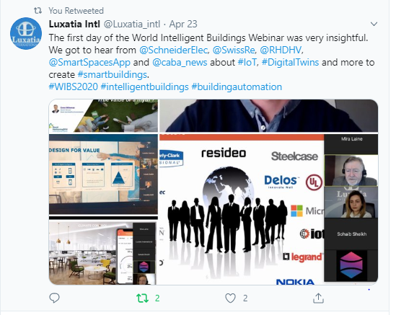
CABA Participation in Virtual Events
World Intelligent Buildings Virtual Conference, April 23-24
"Improving Organizational Productivity with Intelligent Buildings”
Ron Zimmer, CABA
5
© 2020, Continental Automated Buildings Association

Slide 6
CABA Marketing and Outreach
Industry Conference Presentations
"Planning for the Smart Cities of Tomorrow - Using the IEEE P2784 Smart City Planning Guide"
Jim Frazer, ARC Advisory Group
World Intelligent Buildings Virtual Conference, April 23-24
"Connected Home Roadmap"
Glen Allmendinger, Harbor Research, Inc.
"Monetization of Intelligent Buildings"
Glen Allmendinger, Harbor Research, Inc.
"Improving Organizational Productivity with Building Automation Systems"
Greg Walker, CABA
"Improving Organizational Productivity with Intelligent Buildings”
Ron Zimmer, CABA
6
© 2020, Continental Automated Buildings Association

Slide 7
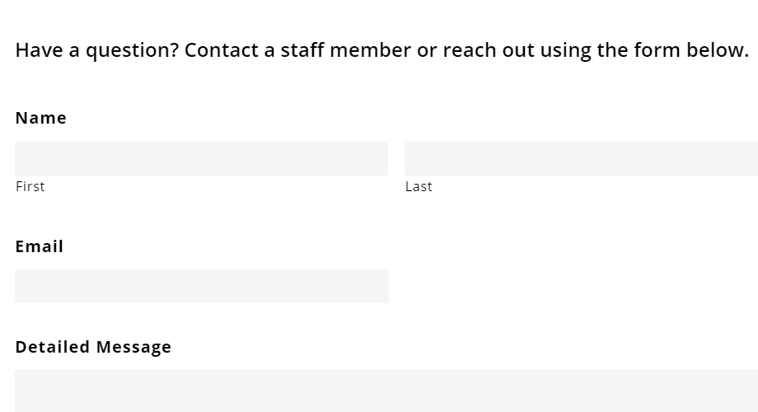
Web site engagement and SEO

Slide 8
Web site engagement and SEO
19% increase in page views from May 2020 to August 2020.
22% in increase in unique page views from May 2020 to August 2020.

Slide 9
Web site engagement and SEO
Typical graph – webinars, eblasts and other promotions drive web traffic peaks
September 16 CABA Connected and Intelligent Buildings Research Available
August 24 IBC Webinar promotion: “Smart Buildings: BEMS, EMIS, FDD, M&V, DCV and COVID"
August 31 CHC Webinar promotion: “Connected Home IoT Cybersecurity Guidelines, Standards and Verification Systems”

Slide 10
Web site engagement and SEO
Channels for inbound traffic may be divided into Direct (69%), Organic Search (21%) and Referral (10%)
Referrals Reflect a Diversity of Sources - with the CABA NewsBrief being the Leading Source
Multiview – 49% LinkedIn 13% Other – 37%

Slide 11
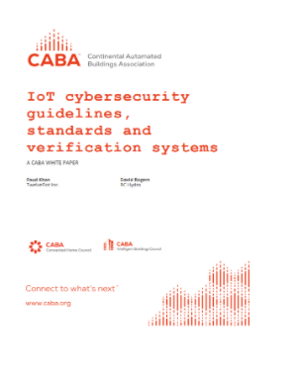
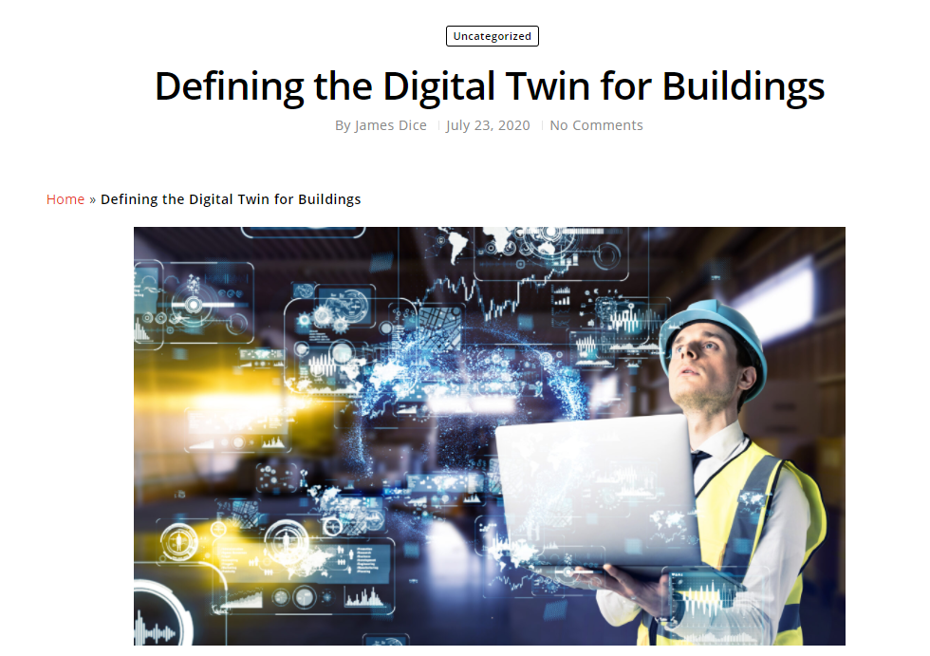
Web site engagement and SEO
Top Landing Pages
CABA Home Page – 46% CABA Research Library (members’ area) 10% Councils – 9% Other – 33% (CABA Journal, CABA White Papers, Research Reports, Membership pages, About Us, Contact Us)
Other examples:
Intelligent Buildings and COVID-19 (2.5%)
“Defining the Digital Twin for Buildings” (2%)
IoT Cybersecurity Guidelines, Standards and Verification Systems (1.4%)

Slide 12
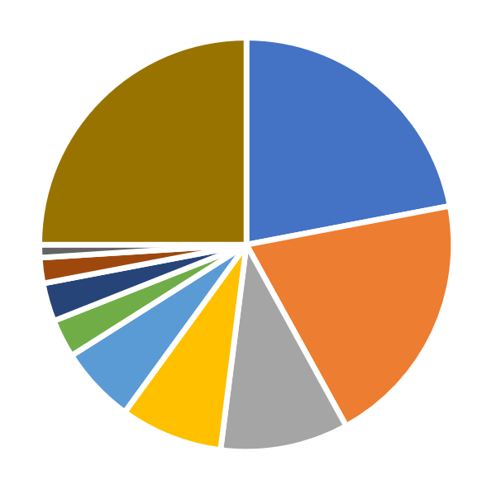
Web site engagement and SEO
Web Site Traffic Categories

Slide 13
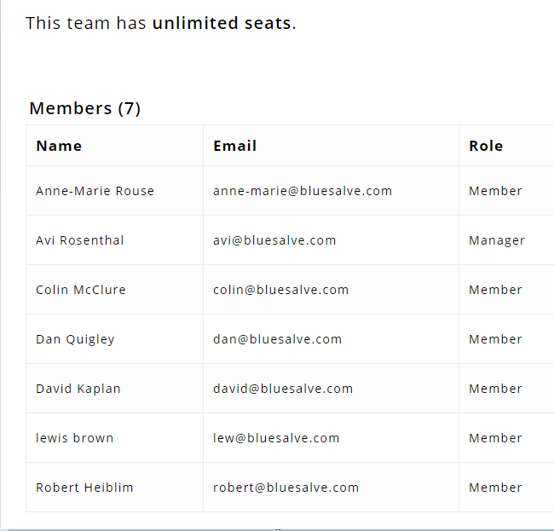
Web site engagement and SEO
Top Report Downloads
1. Intelligent Buildings and Big Data – Full Report 2. Zero-Net Energy Building Controls – Full Report
3. Intelligent Building and the Impact of the Internet of Things – ES
4. Improving Organizational Productivity with BAS - ES
5. Monetization of Intelligent Buildings - ES
Top WP Downloads
1. IoT cybersecurity guidelines, standards, and verification systems
2. Power-over-Ethernet Basics
3. What is LiFi
4. Future delivery/business models for Smart Home services and infrastructure
5. Artificial Intelligence and the IoT Connected Home

Slide 14
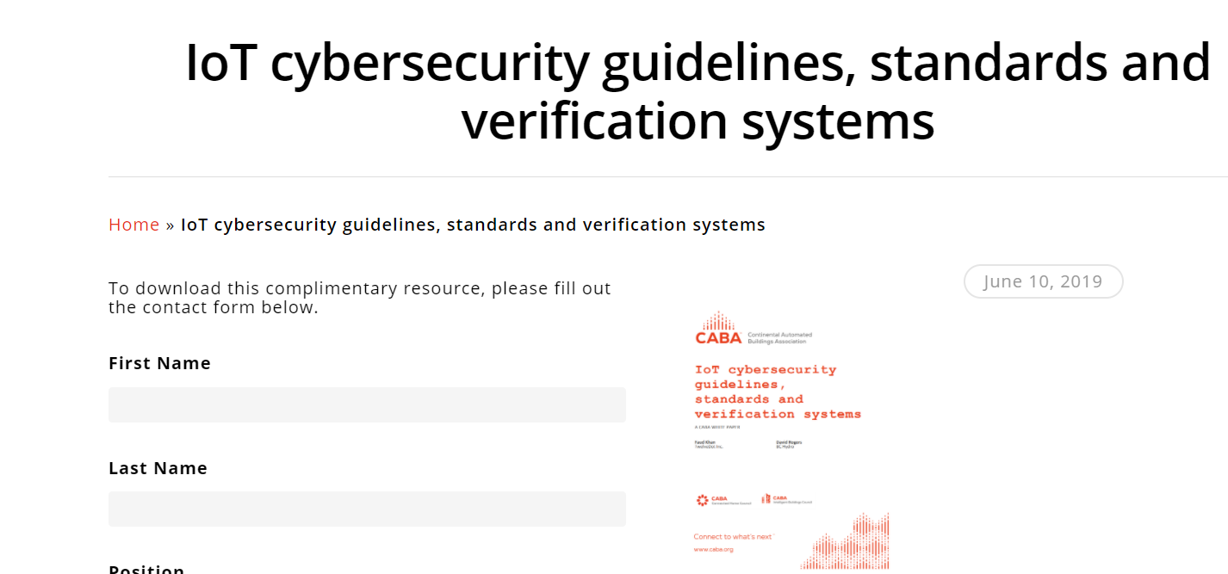
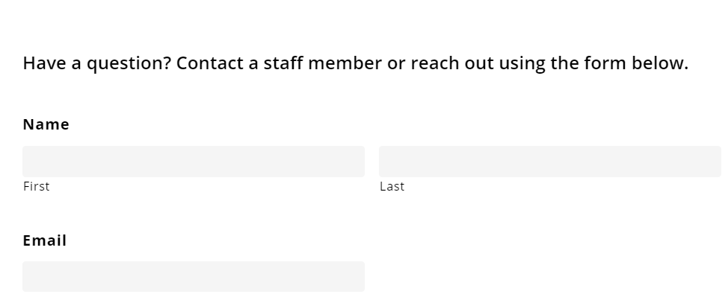
Web site engagement and SEO

Slide 15
B-2. Develop a content marketing strategy to enhance external relations
Identify content appropriate for media and influencers.
Develop lists of individuals to follow, make direct contact and build relations by reposting and inviting content.

Slide 16
CABA Journal – Inviting Content from Industry Thought Leaders
To date, CABA Journal has published approximately five (5) full length (perspective) articles per month. Contributions in recent weeks include, among others:
“Fait Accompli – The Curiously Difficult-to- Predict Future of Software” – Harbor Research
“Is your building a vertical cruise ship?” – Deb Noller, Switch Automation
“Lights, Camera, Action!” – Ken Wacks
IEEE Approves 802.1AS-2020 Timing & Synchronization Standard” – Chantal Polsonetti
“Utility regulators can use efficiency to confront the COVID-19 recession and climate crisis” – Martin Kushler, IEEE
“Defining the Digital Twin for Buildings” – James Dice
“Smart appliances – why they matter for delivering smart buildings” – Chris Irwin, J2 Innovations
“Finding Our Way: Take the Established Success Path for Implementing Building Analytics” – Rob Glance, BuildingFit™
16
© 2020, Continental Automated Buildings Association

Slide 17
Sharing of CABA Content and Messaging
Building and Industrial Automation Industry Focus Launched by Ethernet Alliance
Beaverton, Ore. - Aug. 11, 2020 - The Ethernet Alliance, a global consortium dedicated to the continued success and advancement of Ethernet technologies, today announced the launch of an industry focus around Operational Technology (OT) networks found in building and industrial automation. With development of Single-Pair Ethernet (SPE) creating new opportunities for solving challenges in OT networks, the Ethernet Alliance is seeking to connect with more expertise in the building- and industrial-automation industries. “As the building- and industrial-automation industries come to rely more on SPE, there is a clear need to bring together the people creating and using the technologies so they can better understand one another,” said Peter Jones, chair, Ethernet Alliance. “ ecosystem. This new Ethernet Alliance industry focus will work to align the many disparate stakeholders and, in turn, help the building- and industrial-automation industries get to where they want to go with Ethernet.” One of the key roles that the Ethernet Alliance plays is supporting the deployment of Ethernet technologies into markets not traditionally served by Ethernet. OT networks, which control manufacturing processes or provide occupant comfort and safety in a building, historically have been siloed from Ethernet-based IT networks. . . “We are excited about the Ethernet Alliance’s launch of an industry focus around building and industrial automation,” said Ron Zimmer, president and chief executive officer, Continental Automated Buildings Association (CABA). “SPE is a promising technology for our industry, and CABA's membership of leaders in advancing integrated home systems and building automation worldwide are committed to innovation that empowers connectivity among people, spaces and technology for a better tomorrow.”
17
© 2020, Continental Automated Buildings Association

Slide 18
B-3. Use social media to raise profile of CABA
Add to social media and have CABA staff and industry members join the conversations.
Promote “teaser content” about CABA research on connected homes and intelligent buildings using snackable social media content (visuals, videos, infographics, use cases) to market CABA research products and membership.
Use Board members for viral transmission of snackable social media content as influencers.

Slide 19
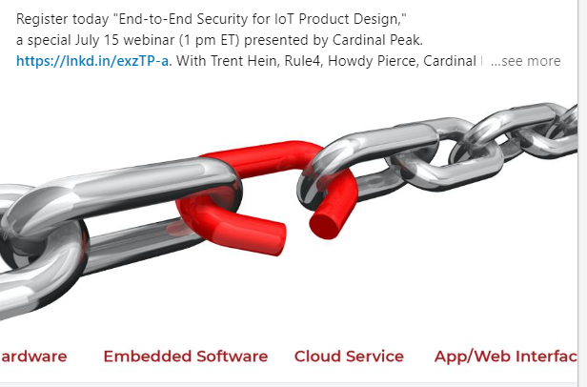
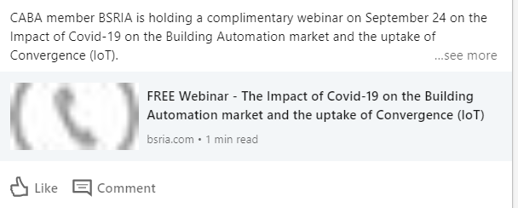
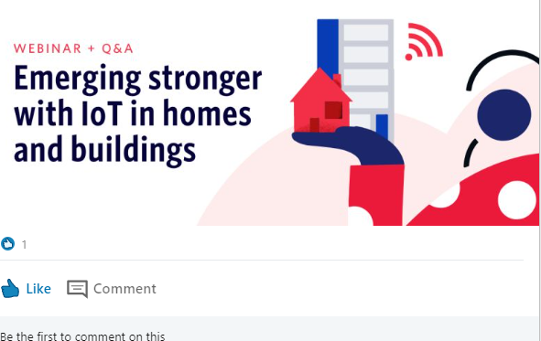
Brand Awareness and External Relations
Marketing on behalf of CABA members and pointing CABA Members to marketing resources (e.g., joining CABA’s LinkedIn Group, use of CABA events page; cross-linking)
19
© 2020, Continental Automated Buildings Association

Slide 20
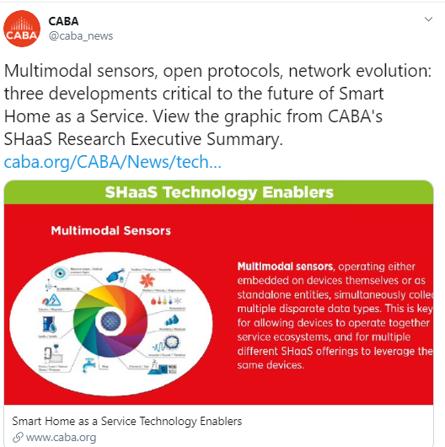
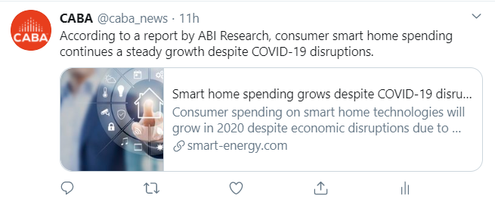
Brand Awareness and External Relations
Marketing of CABA research and sharing of other industry players’ research
CABA White Paper promotion and tracking of downloads
And contacts on the website
Sharing of snackables from
Landmark Research Reports
Sharing of findings by CABA member and other research firms
20
© 2020, Continental Automated Buildings Association

Slide 21
Research Promotion
Forthcoming brand awareness opportunities with three Landmark Projects + BSRIA Project
21
© 2020, Continental Automated Buildings Association

Slide 22
Calls to Action
Identify and participate in more webinar and virtual events.
Continue to encourage CABA Members to join the CABA Ambassador and Speakers Bureau.
Update the CABA web site and add elements to increase the SEO for www.CABA.org and monitor the growth.
Continue the campaign to provide “snackables” and research with the new CABA Research Reports and White Papers.
Consolidate CABA LinkedIn resources
22
© 2020, Continental Automated Buildings Association

