Slide 1









Making Money with Intelligent Buildings
World Intelligent Buildings Summit
April 23-24, 2020
Ron Zimmer, CABA President & CEO

Slide 2

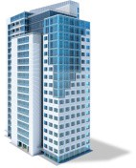


Overview of CABA
CABA (Continential Automated Buildings Association)
Vision
CABA advances the connected home and intelligent buildings sectors.
Mission
CABA enables organizations and individuals to make informed decisions about the integration of technology, ecosystems and connected lifestyles in homes and buildings.
2
Notes:
Presenter
2020-04-21 20:49:31
--------------------------------------------
- 390 members
- 27,000 contacts
Marketing, networking-councils & liaison, Events (SBS)-100 companies
Library, WP, collaborative
----------------------------------------------------------------------------------------------------

Slide 3























CABA Board of Directors
3
Notes:
Presenter
2020-04-21 20:49:32
--------------------------------------------
Our BoD feel this could be the most significant piece of research we can create Different types of organizations
focusing on real ROI True value of the building
2 spots left: share knowledge and network with key companies and individuals in this space.
---------------------------------------------------------------------------------------------------------------

Slide 4
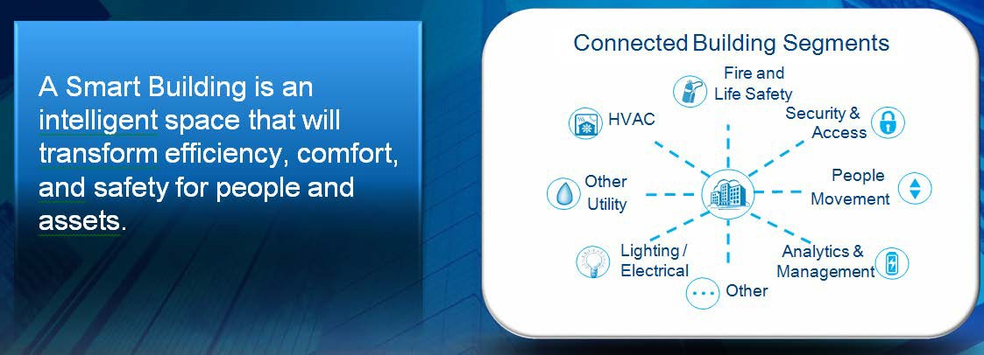

Smart Buildings – Networked, Intelligent, Adaptable…
4
© 2020, Continental Automated Buildings Association

Slide 5
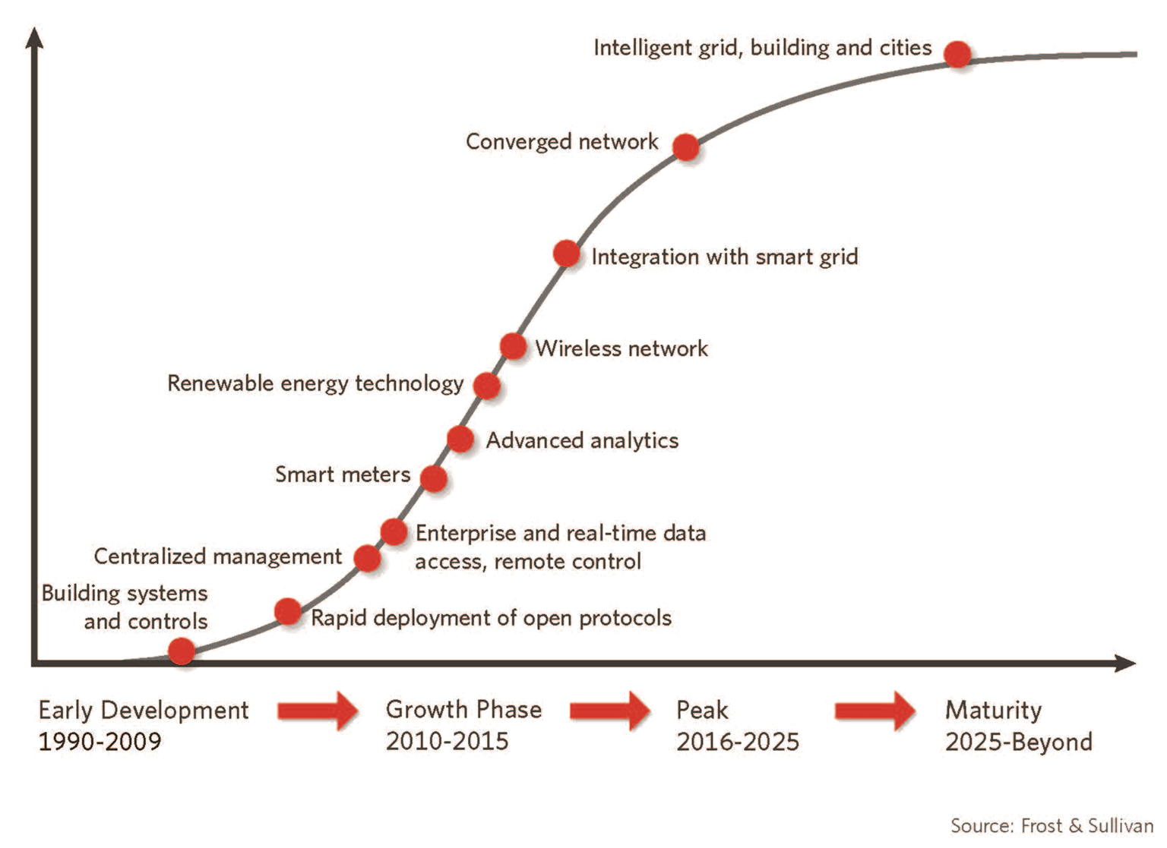
Intelligent Building Solutions Market Lifecycle Analysis
5
© 2020, Continental Automated Buildings Association

Slide 6
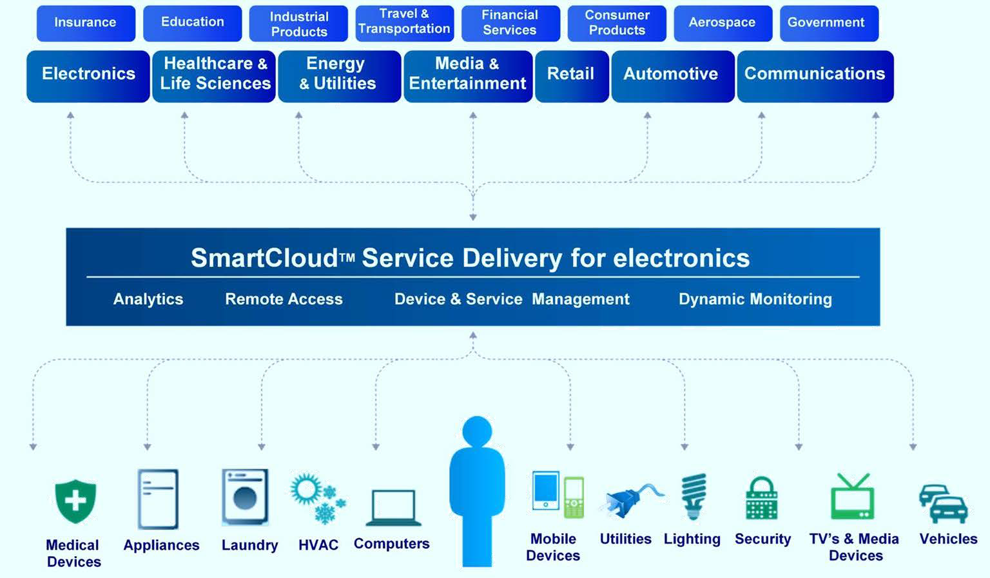
Enterprise Convergence Platform and Cloud Technology
6
© 2020, Continental Automated Buildings Association

Slide 7
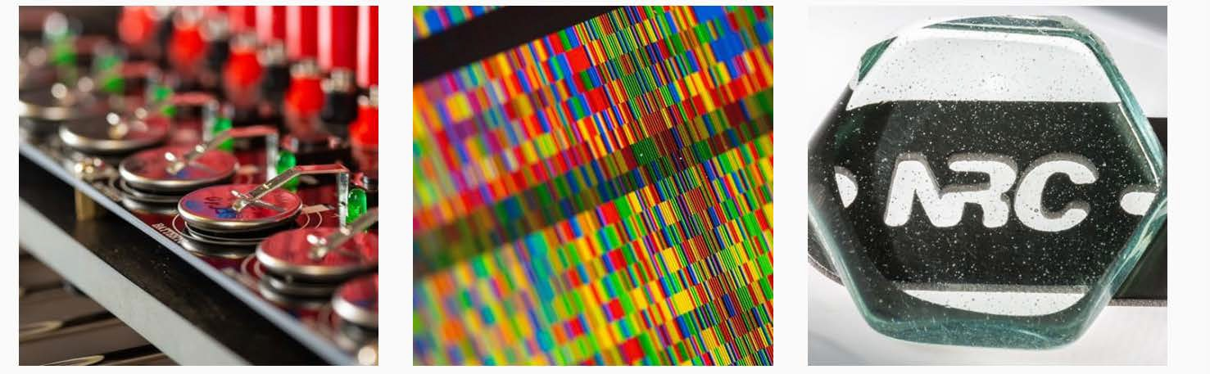


National Research Council
Notes:
Presenter
2020-04-21 20:49:33
--------------------------------------------
- Not able to make it today
One of our 22 member research firms
Government of Canada, about 4000 staff, hundreds of scientists, various expertise, Helped launch CABA 30 years ago
Still on our BoD
Construction part of NRC: national building code, standards, fire protections, civil engineering, national policy Not Canadian research
Everyone will get the first phase for free, talk about 2nd phase later on
------------------------------------------------------------------------------------------------

Slide 8

Project Funders
Notes:
Presenter
2020-04-21 20:49:33
--------------------------------------------
- Thank 8 funders, without their financial support not happened.
- All the funders were on the Steering Committee
Also contributed with insights and direction to the research and shaped an guild the research.
------------------------------------------------------------------------------------------------

Slide 9
Background and Objectives
CABA and its members have expressed a renewed Industry focus on how buildings can:
  Improve organizational productivity
  Contribute to increasing the ROI of building systems
Tenants in a competitive real-estate environments are looking for green, sustainable, comfortable and healthy buildings
In 2014, NRC and CABA collaborated on a White Paper
  Improving Org. Prod. with Building Automated Systems
  Established a framework for quantifying and valuing benefits of an enhanced BAS on Org. Prod.

Slide 10
Background and Objectives
Followed by a CABA Boutique Research Project
  Improving Org. Prod. with Building Automated Systems: Phase 1 was completed by NRC
  Project reviewed published work in engineering, psychology, business, public health, etc.
  Results demonstrated better building strategies having positive effects on multiple org. prod. metrics, comparable in size to other corporate strategies that lack environmental benefits:
    Absenteeism/ Employee turnover intent/ Self-assessed performance/ Job satisfaction/ Health, etc.

Slide 11

Executive Summary
New approach to quantifying organizational productivity effects
“Better buildings” strategies have positive effects on multiple metrics related to organizational productivity
Effects similar in size to other corporate strategies affecting employee health, well-being and performance
Notes:
Presenter
2020-04-21 20:49:34
--------------------------------------------
- Value of the output and the cost it takes to produce those outputs, lots of PKIs on both sides, each organization is difference, returned items or service calls or warrantee item, energy, cost, 3:30:300 (cite JLL) per square foot…terms of total occupancy costs, $3 utilities, $30 rent, $300 employee costs (salaries, benefits, etc.). New approach: multi metric approach for a white collar organization
“better buildings” – what is facilitated by building automation like better ventilation, better lighting, or whole building approach like green building certification. Positively benefit metricises. compare the better buildings approach to other normally taken like : workplace health programs, workplace design, bonuses
------------------------------------------------------------------------------------------------
IMAGE + http://learnaboutgmp.com/building-management-system-bms-validation-overview/ (change for non-copyright image)
In this project we developed a new approach to quantifying the organizational productivity benefits of “better buildings” strategies. First of all, this approach recognises multiple metrics are necessary to define org. prod. Secondly, the effects of better buildings strategies on these metrics are compared to the effects of other corporate strategies. “Better buildings” approaches included in the available literature are technologies facilitated by advanced building automation systems (BAS), or are whole-building strategies (e.g. green building certification) that typically include superior BAS features.
Data on the size of effects were drawn from a comprehensive synthesis of published research in multiple domains. The industry steering committee took a role in refining the approach to ensure the output was of value to practitioners. Better buildings strategies have positive effects that are similar in size to other corporate strategies.
This CABA Boutique Research Project was conducted by the National Research Council Canada (NRC), and received financial and technical support from: Intel, Schneider Electric, United Technologies, Philips, Distech, Pella, and NRC.

Slide 12
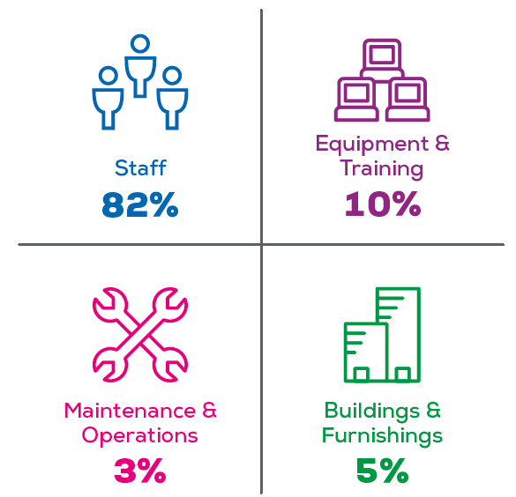
Approach
Use the buildings part of the budget to enhance the salaries and benefits part of the budget
Brill, Weidemann, & BOSTI Associates, 2001
Notes:
Presenter
2020-04-21 20:49:34
--------------------------------------------
- Concept that majority is staff (3:30:300) or 90%.
Example on slides, common one --- cost of staff 82% etc. Over focus on energy
This project is positive focus while increasing health while also increasing productivity
3:30:300 (cite JLL) per square foot…terms of total occupancy costs, $3 utilities, $30 rent, $300 employee costs (salaries, benefits, etc.). small investment in building design and operation can have a relatively big benefit on organizational productivity
-------------------------------------------------------------------------------------------------------------------------
This is a widely-cited breakdown of the costs associated with office workplace costs over a 10-year period (Brill, Weidemann, & BOSTI Associates, 2001). Another common rule of thumb is that the annual operational costs of an office space are, on average $300/ft2 for staff payroll, $30/ft2 for space rent, and $3/ft2 for utilities (Best, 2014). Thus, one would not want cost savings in buildings to come at the expense of staff’s ability to do their work. Ideally an organization would identify building strategies that support the productivity of the organization, and are cost-effective as a whole. In other words, a relatively small investment in building design and operation can have a relatively big benefit on organizational productivity through positive effects on staff (and energy use). The results of this project demonstrate that this is possible.
This CABA Boutique Research Project was conducted by the National Research Council Canada (NRC), and received financial and technical support from: Intel, Schneider Electric, United Technologies, Philips, Distech, Pella, and NRC.

Slide 13
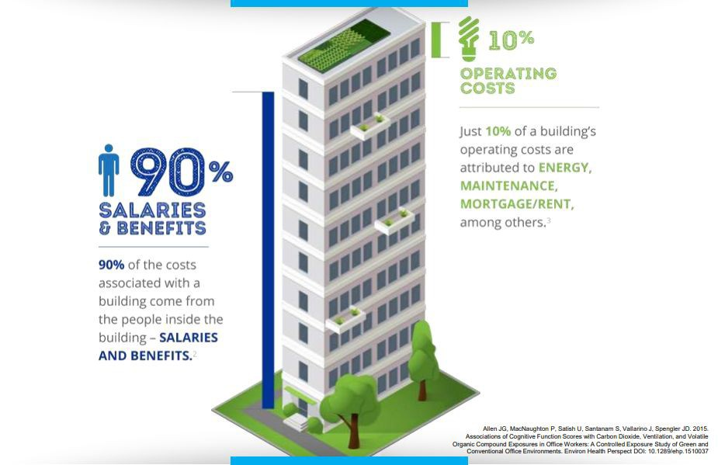
The forgotten 90%
Notes:
Presenter
2020-04-21 20:49:34
--------------------------------------------
- Concept that majority is staff (3:30:300) or 90%.
Example on slides, common one --- cost of staff 82% etc. Over focus on energy
This project is positive focus while increasing health while also increasing productivity
3:30:300 (cite JLL) per square foot…terms of total occupancy costs, $3 utilities, $30 rent, $300 employee costs (salaries, benefits, etc.). small investment in building design and operation can have a relatively big benefit on organizational productivity

Slide 14

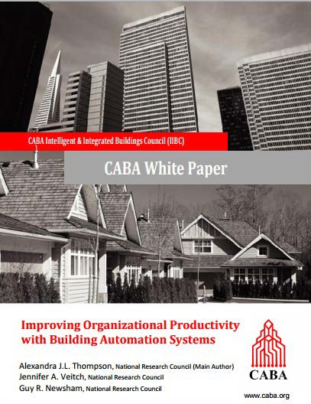


Approach
Traditional productivity thinking not applicable to modern office work
Multiple metric approach from CABA and WGBC
Balanced scorecard concept widely accepted in other contexts
Notes:
Presenter
2020-04-21 20:49:35
--------------------------------------------
-Multi-metric approach because traditional approach not working, traditional how to change building and look at output, problem is hard to measure output.
- Metrics not measure in same way
------------------------------------------------------------------------------------------------
http://www.worldgbc.org/activities/health-wellbeing-productivity-offices/ https://www.caba.org/CABA/Research/White_Papers/CABA/Research/White_Papers.aspx?hkey=dc58d25d-3db4-4273-b05f-471d8d30e00b
No broadly accepted definition of what constitutes appropriate metrics for office work. At one time decision-makers sought very simple cause-and-effect relationships; i.e. “If I replace <BUILDING FEATURE X> with <BUILDING FEATURE Y> then productivity (simply thought of as the amount of work produced by an individual) will increase by Z%”. This is partly a hangover from an industrial production line model of productivity in terms of output of standard units. There is increasing acceptance that such a model is not applicable to most white-collar workplaces, where output is rarely measurable in such terms. Instead, productivity is better represented by a basket of metrics, sometimes measured in different units, that all influence the overall balance of costs and revenues in an organization.
Building features can affect both input costs and output values. Poor indoor air quality could result in increased illness absence (a cost). Employees who are not ill might have increased workloads to compensate for absent colleagues, and this could in turn result in lowered output quality (reduced output value). This is a more complex and nuanced approach than the simple industrial relationship, but offers a pathway to move forward in this domain that an overly simple metric does not offer. Oseland and Burton (2012) noted that while most researchers acknowledge that there is an under-appreciated relationship between office design and environmental conditions and (organizational) productivity, the fact that it is difficult to quantify means that it is.
The only metric typically used in relation to the workplace has been size, which has led to strategies that promote density, and thus a saving on the one metric used, rather than the well-being and performance of those inhabiting the space. Indeed, Oseland and Burton (2012) found that “… only one in eight organizations had productivity metrics in place and none monitored the relationship between the environmental conditions and business performance.” Lacking metrics in this domain, organizations tend to focus on the real-estate costs of space, which are easily measured and monetized. This is exacerbated by the classic split incentive problem, facilities management typically reports to the CFO/COO, with a motivation to cut costs, rather than to an executive with a responsibility for employee well-being or workflow optimization (The Stoddart Review, 2016).
Multi-metric definitions for organizational productivity have emerged from major international organizations in recent years; i.e. CABA and the WGBC. Such a balanced scorecard approach is now common in other domains for business decision-making. WGBC also noted that data on many of these metrics already exist in most large organizations, but are not typically collated and correlated with building conditions. We’ll list these metrics on later slides. This CABA Boutique Research Project was conducted by the National Research Council Canada (NRC), and received financial and technical support from: Intel, Schneider Electric, United Technologies, Philips, Distech, Pella, and NRC.

Slide 15


Approach – analogy to improving energy performance
Does my energy performance need to be improved?
→ benchmarking
Assess several strategies to improvement
Benefits often better expressed in equivalent terms
# cars off the road Planting # trees
Apply this process across multiple metrics related to organizational productivity
Notes:
Presenter
2020-04-21 20:49:35
--------------------------------------------
Most start with benchmarking, so we did that also Look at what strategies
Most benchmark using analogies or equivalencies
Monetization has to be done locally (utility cost change from place to place, for example)
---------------------------------------------------------------------------------------------------------
IMAGE + https://openclipart.org/
It might be helpful to compare elements of our approach with org. prod. to way that energy efficiency upgrades are evaluated.
The energy process usually begins with benchmarking. If a building operator benchmarks their building’s energy use against other similar buildings and observes underperformance, they obtain a signal that energy saving in their building is a reasonable priority, and is likely to be fruitful. Similarly, establishing suitable benchmarks for the proposed organizational productivity metrics will enable decision-makers to understand whether or not their own building’s metrics are lower than desired. This might be expected to motivate them to look at options to improve these metrics.
Several options to improve energy performance would then be considered, and their expected costs and benefits, based on existing knowledge and case studies, compared. These costs/benefits must be assessed by experts locally, as the local costs of labour, components, and energy will vary from place to place. Similarly, multiple approaches to improving org. prod. may be considered and their costs/benefits evaluated using local multipliers. Rather than providing simple monetary equivalents we propose to provide the information to organizations such that they can go through a monetization exercise themselves, should they wish to do so, using assumptions and multipliers that unique to them. Note that when talking about energy upgrades, the benefits are often expressed in equivalent units, it is like taking so many cars off the road, or planting so many trees. The positioning of such information in different units (cars, not dollars, not kWh) can be more appealing to some decision-makers.
As an example, consider a relatively straightforward metric of clear organizational value, absenteeism. Suppose we demonstrated that a particular building technology reduced absenteeism by one day per person per year. It may be true that a workplace health program can also be shown to reduce absenteeism by one day per person per year. In this (fictitious) example, one could say that installing this building technology was like giving everyone access to a workplace health program (with respect to absenteeism, at least!). This CABA Boutique Research Project was conducted by the National Research Council Canada (NRC), and received financial and technical support from: Intel, Schneider Electric, United Technologies, Philips, Distech, Pella, and NRC.

Slide 16
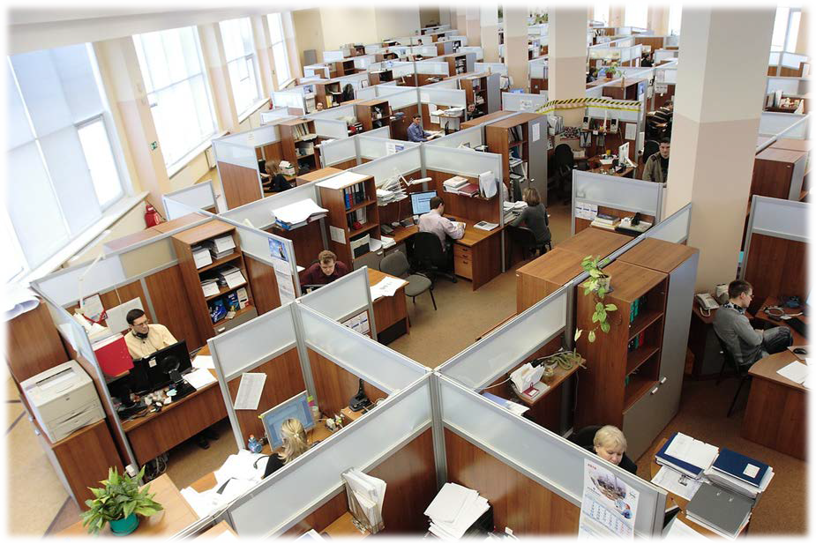
Organizational Productivity Metrics
Absenteeism
Employee turnover intent
Self-assessed performance
Job satisfaction
Health and well-being
(Complaints to the FM)
Benchmark developed for each
Notes:
Presenter
2020-04-21 20:49:36
--------------------------------------------
6 metrics
-we thoughts complaints to the FM would be valuable but we were not able to find much info on this metric. This is a research gap to be filled
not arbitrary --interplay of workplace environment elements, employee effects and behaviours, and organizational outcomes established by a logical connecting of multiple well-established studies. No single study has ever measured all of these metrics and demonstrated their interaction.
Complaints to the facility manager was a target metric, but we were unable to find any usable studies – this is an important research gap.
-Benchmarks were derived from national statistical databases, or sizable peer-reviewed studies of representative buildings.
---------------------------------------------------------------------------------------------------------
IMAGE + https://pixabay.com/en/russia-office-men-women-working-95311/
This is the set of org. prod. metrics used in this study, each of which have self-evident value to any organization.
The choice of these metrics was not arbitrary. They were derived from a conceptual model of the interplay of workplace environment elements, employee effects and behaviours, and organizational outcomes established by a logical connecting of multiple well-established studies. No single study has ever measured all of these metrics and demonstrated their interaction. Complaints to the facility manager was a target metric, but we were unable to find any usable studies – this is an important research gap.
Benchmarks were derived from national statistical databases, or sizable peer-reviewed studies of representative buildings.
This CABA Boutique Research Project was conducted by the National Research Council Canada (NRC), and received financial and technical support from: Intel, Schneider Electric, United Technologies, Philips, Distech, Pella, and NRC.

Slide 17
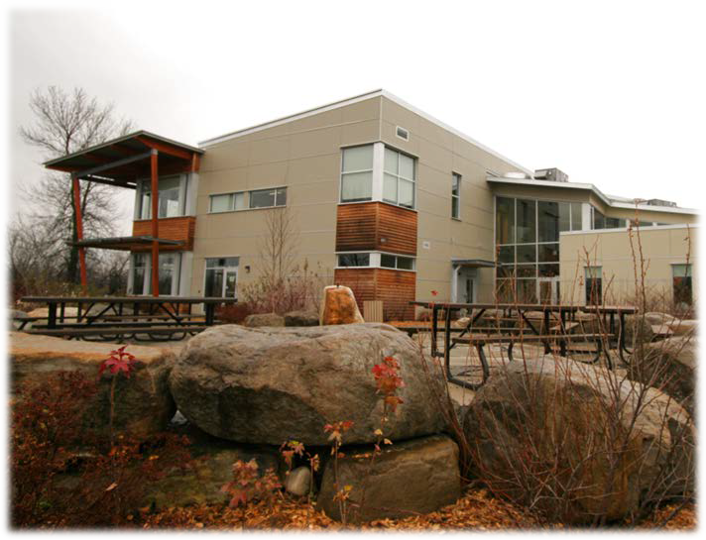
Corporate Strategies
Better buildings
Office type
(private vs open-plan)
Workplace health programs
Bonuses
Flexible work options
Peer-reviewed literature synthesized for effects on each organizational productivity metric
  > 4000 abstracts, and 500 full publications reviewed
  Studies from real office workplaces only
Notes:
Presenter
2020-04-21 20:49:37
--------------------------------------------
Multiply strategies, “better buildings” compared to 4 others. Wanted to have a level of comparison Workplace health programs (health screening, advice for nutrition, fitness program) Flexible work (working from home)
Variety of sources: engineering, psychology , health etc. 4000 abstracts and narrowed it down to 500 research report One filter is find studies in real workplaces only, not lab
---------------------------------------------------------------------------------------------
IMAGE + NRC owned
We chose to focus on strategies that we believed would be familiar to a building manager (e.g. Bonuses) or strategies that might be implemented by, or with the participation of, the building manager themselves (e.g. Office Layout, Flexible Work Options).
Better Buildings: studies comparing outcomes from buildings with an advanced BAS vs. buildings without one, are rare or non-existent. Thus, we broadened our outlook to studies that addressed elements associated with a typical BAS in the larger sense (e.g. ventilation enhancement, advanced lighting controls), or whole-building approaches that would typically include a BAS upgrade or improvements to BAS elements (e.g. green buildings).
Office Layout: Focus on comparison of private offices vs. open-plan. The justification for the general trend towards open-plan has typically been the expectation that it will bring increased flexibility, transparency, and enhanced communication between team members, although the underlying economic driver has been real estate-cost savings. It is a very familiar strategy, and thus serves as an excellent touchstone against which to compare other strategies. Workplace Health Programs: WHPs often form part of the benefits package in large organizations, with the general belief that this investment will support employee well-being, which in turn will benefit the organization’s productivity . WHPs tend to be offered as packages of measures designed to promote good health; e.g., health counselling, gym access, nutrition programs, stress management, physical tests (e.g., blood pressure).
Bonuses: It is a common belief that financial incentives offered to individuals will elicit employee behaviours and perceptions that will benefit organizational productivity. We focus on bonuses provided for general job performance, typically evaluated by a manager.
Flexible Work Options: Studies have typically looked at a package of options. This category can include flexibility in scheduling working hours to be conducted in the organization’s own building, the availability of multiple workplace locations within the building, or the ability to telework. The scope of this work is highly multi-disciplinary, and thus the literature search encompassed many fields, including business, medicine, psychology, engineering, and facilities management.
This CABA Boutique Research Project was conducted by the National Research Council Canada (NRC), and received financial and technical support from: Intel, Schneider Electric, United Technologies, Philips, Distech, Pella, and NRC.

Slide 18
Results
 | Strategies (IV)➔ | Better Buildings | Office Type | Workplace Health Programs | Bonuses | Flexible Work Options
Benchmark ⬇ | Metrics or KPIs (DV)⬇ |  |  |  |  |  | Unit ⬇
2 – 15 | Absenteeism | ⬇ 0.4 – 1.5 | ⬇ 3.2 | ⬇ 0 – 1.8 | ⬇ 1.0 |  | day/per/yr
18 – 30 | Employee Turnover (int.) | ⬇ 1.3 | ⬇ 18 | 0 | ⬇ |  | 0 – 100
0 | Self-assessed Performance | ⬆ 2 – 10 | ⬆ 8– 15 | ⬆ 0 – 10 | ⬆ |  | %
60 – 80 | Job Satisfaction | ⬆ 4 – 9 | ⬆ 5 – 10 | ⬆ 0 – 12 |  | ⬆ 0 – 10 | 0 – 100
30 – 60 | Health & Well-being (symptoms) | ⬇ 5 – 9 | ⬇ |  |  |  | 0 – 100
55 – 75 | Health & Well-being (overall) | ⬆ 6 – 10 | ⬆ 11 – 12 | 0 |  | ⬇ 6 | 0 – 100
Notes:
Presenter
2020-04-21 20:49:38
--------------------------------------------
5000 publications into one table
Arrow is direction of effect, arrow with no number means consistent in literature but not able to quantify a table. Explain fields: empty, arrows etc., benchmarks etc.
Absenteeism:
unit (days/person per year), 2-15 is normal (full report by industry and country), better buildings (lighting control, ventilation, green buildings), consistent finding. Mixed in flexible Employee turnover:
-intent to turnover (like – in next year do you intent to look for another job, 0 means very unlikely, 100 mean very likely). National databases normal is 18-30. for example 25 does not mean that 25% are looking for a new job means on average people are somewhat unlikely looking for a new job. Self-assessed performance:
hard to objectively asses performant in workplace. Typically use self assessment. Typically use % scale. For example 0% means no change in productivity, normally -30% to +30%. 0 benchmark because its relative Job satisfactions:
-say most important: commonly asked questions “in general how satisfied are you with your job for example”. Converted to scale 0-100 (100 very satisfied), bench mark is 60-80 so overall people are generally happy Health
Symptoms: asking about specific symptoms (frequency, intensity) Benchmark is 30-60. 0=no symptoms, 100=lots of symptoms all the time. Very buildings specific because of many studies in sick buildings syndrome Overall: common is social surveys: people are generally happy. 0=unhappy, 100-happy. Interesting that health programs have no effect
Take aware: - “better buildings increase all metrics and Take Away: 1) “better buildings” positively impact all metrics
2) similar to in every case similar to other types of programs organization use
Putting it in this format you can see the similarities, in hope not to just see better buildings as just energy improvements
open offices things does not get better (lower in all metrics). Lots of studies over 30 years, more literature on this than any other options
----------------------------------------------------------------------------------------------------------------
-better buildings defined in a board way deliver benefits in higher or the same as tradition was like health programs, bonuses, flexable work options
One expetion is office layout – open offices things does not get better (lower in all metrics). Lots of studies over 30 years, more literature on this than any other options. Number of studies that made it into the table was fewer due to high criteria. Hundreds I think. Flexable work options is only one we fund with contradictory studies, no consistant result one way or the other.
How to read table: benchmarks looks at international metrics on population levels to find the normal levels (buro of labor and statisics for example), ragne is 2-15 for absenteisum for example, he better building collum (grean vs conventiaional, luverserd vs direct or iundirect) if you make the change to a better buildings you can make a change. Office layout ---open to closed office, absenteisum may be more impacted because of less exposure to tgerms. Open office trend has be going on for over 50 years,
The final Matrix showing the benchmarks for each metric, and the effects of various corporate programs. The benchmark has a purple background if it was derived from national/international statistical surveys, and no background if it was derived from targeted research studies or theory. The arrow in each cell indicates the direction of the effect. The number in cell indicates the size of the effect (in the same units as the benchmark). An arrow without a number indicates that the direction of the effect is established, but a size was not derivable (in our preferred terms) from the published studies. The effects attributed to Better Buildings strategies are highlighted as they are the primary interest of the project. The number in the cell represents the preponderance of available information, and is based on our judgement (i.e., it is not the result of a quantitative meta-analysis). We present a range if several studies contributed a variety of results. That range might start at zero if several studies found no effect and several found consistent effects. Empty cells denote combinations of corporate strategies and KPIs for which we found no relevant studies on which to base a conclusion.
Study results and benchmarks have been rescaled into common units using straightforward assumptions and linear translation, and not any formal statistical method. Explanation of units for each metric:
Absenteeism [Unit: Days/person/year] LOWER is better
Focus on short-term sick leave that an employee takes for their own illness, and following their own assessment of their health. This is often self-reported by employees on surveys, but might also be derived from HR databases. Employee Turnover [Unit: 0-100 scale (likelihood to look for another job)] LOWER is better
Our focus was on data assessing whether someone leaves their job voluntarily (the inverse of employee retention)
This metric is based on survey data on turnover intent. Questions in different surveys are worded differently, as are the response scales. A typical question might read, “How likely is it that you will make a genuine effort to find a new job with another employer within the next year?” A typical response scale might have seven distinct categories with end labels “Extremely Unlikely” to “Extremely Likely”. To convert this to a common 0-100 scale these labels would be assigned a value; e.g. 5 and 95, respectively, with other labels in between pro-rated. All responses from a group would then be averaged to find a value for a population, organization, or building. Note that an organizational average of 25 on this scale would mean that, on average, employees say they are “somewhat unlikely” to be looking for another job, not that 25% of employees are actively looking for a new job. Self-assessed Performance [Unit: % scale] HIGHER is better
Employees have been asked to self-assess their own productivity in their own workplace. A typical question phrasing by researchers might be, “Please estimate how you think your personal productivity at work is increased or decreased by the physical environmental conditions”, with a seven-point response scale from -30% to +30%. In NRC’s interpretation, this is unlikely to be a reliable measure of an employee’s actual material output in percentage terms, and is more a measure of environmental satisfaction in the sense of how the indoor environment supports the employee’s ability to do their job. Job Satisfaction [Unit: 0-100 scale] HIGHER is better
Many different question wordings (and single items or averages of multiple items) and scales have been used in many studies. An example single-item scale is, “Taking everything into consideration, what is your degree of satisfaction with your job as a whole?” rated on a seven-point scale from “Very Unsatisfactory” to “Very Satisfactory”. We used judgement to interpret the equivalence of different question formats and to normalized the data from each study to a common 0-100 scale (see note on turnover intent above). Health and Well-being (symptoms) [Unit: 0-100 scale] LOWER is better
In the buildings research domain, the prominence of Sick Building Syndrome (SBS) led to the relatively frequent use of surveys to assess associated symptoms. These symptoms included dry eyes, runny nose, back pain etc. Survey methods included asking about frequency or intensity, or both, and these survey items prevailed in some studies after the SBS phenomenon subsided. Again, the equivalence of these different question formats was considered to re-scale the results from individual studies to a common scale. For example, 10=very mild/infrequent health symptoms; 90 = frequent/intense health symptoms in a population. Health and Well-being (overall) [Unit: 0-100 scale] HIGHER is better
Surveys are often used to determine an individual’s general state of health or well-being. These have included both national and international social surveys, and individual research studies. These data were also normalized from the scales reported to a common 0-100 scale. For example, 10=very poor overall health in a population; 90 = excellent overall health in a population. This CABA Boutique Research Project was conducted by the National Research Council Canada (NRC), and received financial and technical support from: Intel, Schneider Electric, United Technologies, Philips, Distech, Pella, and NRC.

Slide 19

Research Gaps
New outcomes for high-profile concepts; e.g., employee engagement, creativity, new employee attraction, communication, and presenteeism
Analysis of archived FM complaints data
Longitudinal data analysis to establish causation and persistence of effects
Measures of in-situ job performance
Leverage Internet of Things (IoT), and wearables, to enhance existing metrics, or to develop new metrics
Common measurement scales, and reporting formats
Notes:
Presenter
2020-04-21 20:49:38
--------------------------------------------
New outcomes are little research and not common definitions. Need to incorporate these in future research
- lots of studies were done at one point in time not longitudinal. Need to have more longitudinal (long term) to have 2 benefits…..1) stronger handle on causation, 2) persistence of effect over time, many looked at effect soon after and need to look to see if this carries over time Difficult to measure job performance…..challenge to find new ways to address this challenge
Hard to compare studies side by side (job satisfaction for example)
-----------------------------------------------------------------------------------------------
IMAGE + https://pixabay.com/en/office-pen-calculator-computation-1574717/
While delivering valuable results, this project highlighted several gaps in the research where more work would be particularly valuable in understanding how investments in better buildings will improve org. prod.
Many involved in organizational improvement speak of a desire to improve concepts such as employee engagement, creativity, new employee attraction, communication, and presenteeism. However, they do not typically have systems in place to measure them, and researchers have not yet developed standard measures either.
We have used the term “organizational productivity” throughout to take the spotlight away from the performance of individuals and place it on the bigger picture. Nevertheless, the performance of individuals does have a role in the determination of organizational productivity. It is recognized that simple task performance measures are unavailable or not relevant in the modern, white-collar office, so what replaces them? Most prior studies have sampled data at a single point in time. Studies over long time periods would provide stronger statistical conclusions, and indicate the persistence of various measures.
A surprising gap in the literature was the lack of studies with complaints to the FM as an outcome. Surprising because the data are routinely archived, and it seems like such an obvious outcome for buildings researchers. It would be particularly valuable if associated BAS data could also be provided. This is also an area in which a business case could be made in a relatively straightforward manner. Even excluding the (potentially large) benefits that lowering occupant discomfort might have for a range of organizational productivity metrics, responding to a complaint has tangible costs too, with both fixed (“truck roll”) and variable (labour and parts to resolve the problem) components. It is a straightforward hypothesis that better buildings (or changes to office layout, or flexible work options) would lower complaints and thus direct FM costs. IoT, wearables etc. promise lots of new data and ways of measuring organizational behaviour in new ways.
Having a common agreement on how to measure the various org. prod. metrics in a consistent way would improve the comparability and value of studies going forward.
This CABA Boutique Research Project was conducted by the National Research Council Canada (NRC), and received financial and technical support from: Intel, Schneider Electric, United Technologies, Philips, Distech, Pella, and NRC.

Slide 20

Phase 2:
Task Force
Bianca Van Der Zande (Philips)
Brandon Buckingham (Steelcase Inc.)
Craig Walker (United Technologies Research Center)
David Sapoznikow (Intel Corporation)
Greg Walker (CABA)
Jennifer Veitch (National Research Council)
Rachna Stegall (UL LLC)
Rimes Mortimer (Microsoft Corporation)
Ron Zimmer (CABA)
Stephen Becker (Kimberly-Clark Professional) Trevor Nightingale (National Research Council) Tucker Boren (Acuity Brands, Inc.)

Slide 21
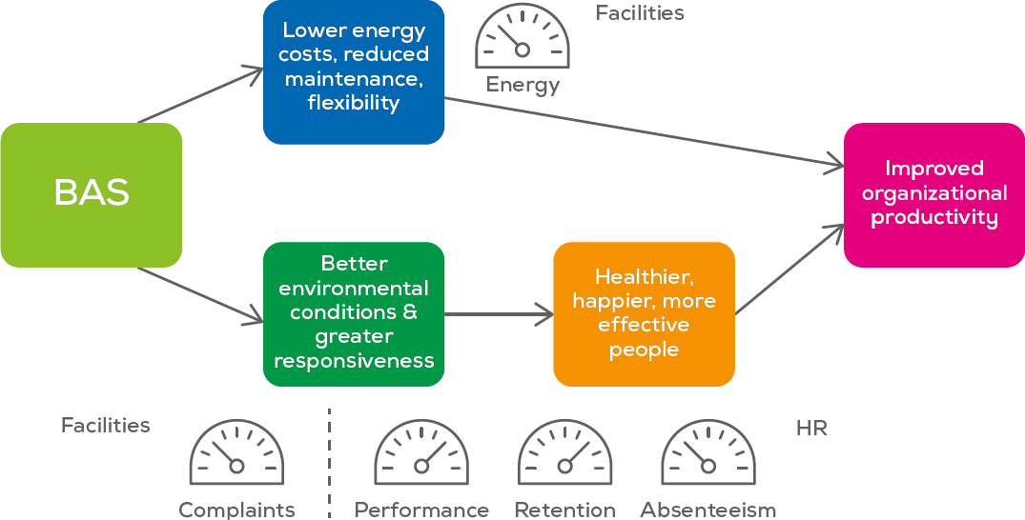
Phase 2: Overview
Phase 2 will examine the effect of building characteristics and systems on multiple metrics in the same organization
Much of the necessary data already exists – it then must be accessed, collated and analyzed by building features
Consortium of funding and data partners via CABA
Notes:
Presenter
2020-04-21 20:49:40
--------------------------------------------
2 Parts to better buildings, most think about the upper part first, the lower is the harder and what we will focus on----reduce input cost and increase the value of the outputs.
- Where does the needle fall, using data that was already collected for other purposes (facility and HR data). Phase 2: what is it about the building specifically not general
- Most organizations already have this data, 2 pathways
------------------------------------------------------------------------------------------------------------
The results from Phase 1 (this study) involved many different studies from many buildings to fill in the cells in the results table. Phase 2 will aim to look at the effect of buildings strategies on multiple outcome metrics in the same building(s). This will validate the multimetric approach, and will enable closer attribution to specific building parameters. In many of the studies reviewed in Phase 1 the researchers deployed measurement procedures of their own, and this is likely not scalable if we want to firmly establish the links between building characteristics and organizational productivity outcomes.
The figure (drawn from the CABA white paper described on slide 4) illustrates the two main pathways by which a BAS can affect organizational productivity metrics. The upper pathway is via reducing energy costs; the lower pathway is the focus of Phase 1, which is via improved workplace conditions that in turn support employee health, well-being, and ability to perform their tasks effectively. A key insight from the WGBC report (described on slide 4) was that data on many of these important metrics already exist in an organization and are collected routinely. It may be a matter of securing permission to use existing data sources for this purpose, collating them, parsing them by building, and associating them with local building characteristics. For example, HR databases might already hold data pertaining to staff retention/turnover, absenteeism, and other aspects of employee health and well-being. HR also often conducts regular employee opinion surveys that contain data on job satisfaction and organizational commitment. The marketing departments, and the finance department may have data on business unit performance. Many office building landlords regularly administer tenant satisfaction surveys that contain items related to environmental satisfaction. The FM company often maintains a database of complaints about the built environment registered by individuals, as well as the response time and cost. The FM might also keep historical records from the BAS, which will provide data on some key physical indoor environment conditions, such as space temperature and RH, and zone-level CO2 concentration. The proposed next phase of this work (Phase 2) will seek to engage a larger consortium of industry partners to provide the data from multiple data holders around the same building populations, and to fund its analysis.
This CABA Boutique Research Project was conducted by the National Research Council Canada (NRC), and received financial and technical support from: Intel, Schneider Electric, United Technologies, Philips, Distech, Pella, and NRC.

Slide 22


Phase 2: Work Plan
The work under Phase 2 will compromise two stages:
  Acquisition of relevant anonymized RE and HR data from one or more partner organizations
  Analysis of these data to quantify how investments in building technologies affect org. prod. Metrics
Retrofit 1
Retrofit 3
Retrofit 2
Bldg 1
Bldg 2
Bldg 3
Bldg 4
HR survey & data 1
HR survey & data 2
HR survey & data 3
HR survey & data 4
Notes:
Presenter
2020-04-21 20:49:40
--------------------------------------------
Greg: Naturalisti demonstration of retrofit benefits – comparing archival data to assess changes. Horizontal line being a buildings, retrofit is a dot, vertical line is data collection.
Comparing different retrofits and satisfactions on buildings.
retrofits (addition of new ventilation systems—under floor vs over head ventilation for example). Maybe you might want to think about this other intervention. Not sending out our survey but using their own surveys.
-------------------------------------------------------------------------------------------------

Slide 23
Phase 2: Deliverables
Project partners will
  form a steering committee to shape research decisions
  have the opportunity to review draft documents, and provide comments prior to delivery of final versions
    Detailed report
    PowerPoint slide deck
    Version of final report edited for submission to a scientific journal

Slide 24

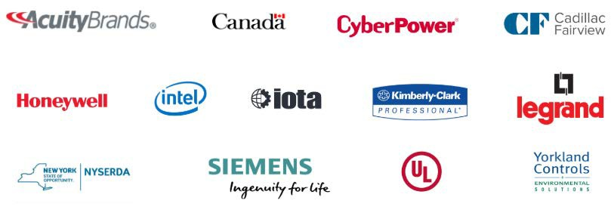

Research Update
2019 IBC Landmark Research “Evidence for Building Retrofits that Improve Organizational Productivity (Phase 2)” (15)
Free Download of Phase 1: www.caba.org/productivity
www.caba.org/research
Notes:
Presenter
2020-04-21 20:49:40
--------------------------------------------
Data is not free, organization paid something to get it, there fore the company that brings data to the table can join free of charge,. Barter for one large organization from has many sites, more likely to have the large amounts of data over time, banking or insurance or large companies. Ideal with a large workforce with similar types of jobs (ideally white color work). Marketing and selling point for the company that contributes data
-----------------------------------------------------------------------------------------------------

Slide 25
2020 CABA Research
“Privacy and Cybersecurity in the Connected Home”
“Intelligent Building Energy Management Systems”
Notes:
Presenter
2020-04-21 20:49:40
--------------------------------------------
Data is not free, organization paid something to get it, there fore the company that brings data to the table can join free of charge,. Barter for one large organization from has many sites, more likely to have the large amounts of data over time, banking or insurance or large companies. Ideal with a large workforce with similar types of jobs (ideally white color work). Marketing and selling point for the company that contributes data
-----------------------------------------------------------------------------------------------------

Slide 26
CONTACT CABA
Continental Automated Buildings Association (CABA)
613.686.1814
Toll free: 888.798.CABA (2222)
caba@caba.org www.CABA.org www.twitter.com/caba_news
www.linkedin.com/groups?gid=2121884
Connect to what’s next™

